Slide 1
Computer Organization & Assembly Language
Lecture 3

Slide 2
Programming Model x8086
Structure of an Assembly Language Program
.model small ; Select a memory model.
.stack stack_size ; Define the stack size
.data ; Variable and array declarations;
; Declare variables at this level
.code
main proc ; Write the program main code at this level
main endp

Slide 3
Model
Defines the number of code and data segments a program can have.
Small: For 1 code and 1 data segment. Code and data are located in a single 64 KB segment. Well-suited for small programs that fit within the 64 KB limit.
Medium: for 1 data and more than 1 code segments. Code and data have their own separate 64 KB segments. Suitable for larger programs, providing more flexibility.
Large: for more than 1 code and data segments. Supports multiple code and data segments, each up to 64 KB in size. Useful for even larger programs, but with increased complexity.

Slide 4
Stack
In 8086 assembly language programming, the .stack directive is used to define the size of the stack segment. The stack segment is a region of memory reserved for the stack, which is a data structure used for storing temporary data such as local variables and return addresses.
The syntax for specifying the stack size is:
.stack size_in_bytes
The stack size should be chosen based on the needs of your program.

Slide 5
Code & Data
In 8086 assembly language programming, the .code directive is used to specify the beginning of the code segment. The code segment is where the actual executable instructions of your program reside.
In 8086 assembly language programming, the .data directive is used to define the data segment. The data segment is a section of memory where you allocate and initialize variables that your program will use.
Examples:
message db 'Hello, Assembly!', '$'
count dw 0

Slide 6
Machine Instruction Elements
Each instruction must have elements that contain the information required by the CPU for execution.
These elements can be:
  Operation code: Specifies the operation to be performed (e.g.. ADD, I/O). The operation is specified by a binary code, known as the operation code, or opcode.
  Source operand reference: The operation may involve one or more source operands, that is, operands that are inputs for the operation.
  Result operand reference: The operation may produce a result. Also called destination operand.
  Next instruction reference: This tells the CPU where to fetch the next instruction.

Slide 7
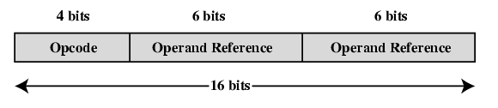
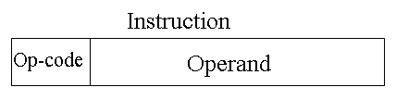
Instruction Representation
Within the computer, each instruction is represented by a sequence of bits.
16 bits instruction
  4 bit opcode, 6 bit operand 1, 6 bit operand 2
  4 bit opcode, 12 bit operand
32 bits instruction
64 bits instruction
Figure: A Simple Instruction Format

Slide 8
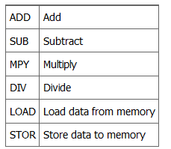
Contd..
Binary representations of machine instructions is difficult to remember.
Use a symbolic representation of machine instructions.
Opcodes are represented by abbreviations, called mnemonics, that indicate the operation. Common examples include:

Slide 9
Some Rules To Follow
Both source and destination operands should be the same size.
Both operands cannot be segment registers
The destination operand cannot be a CS or an IP register
If the destination operand is a segment register, the source operand cannot be an immediate value.

Slide 10
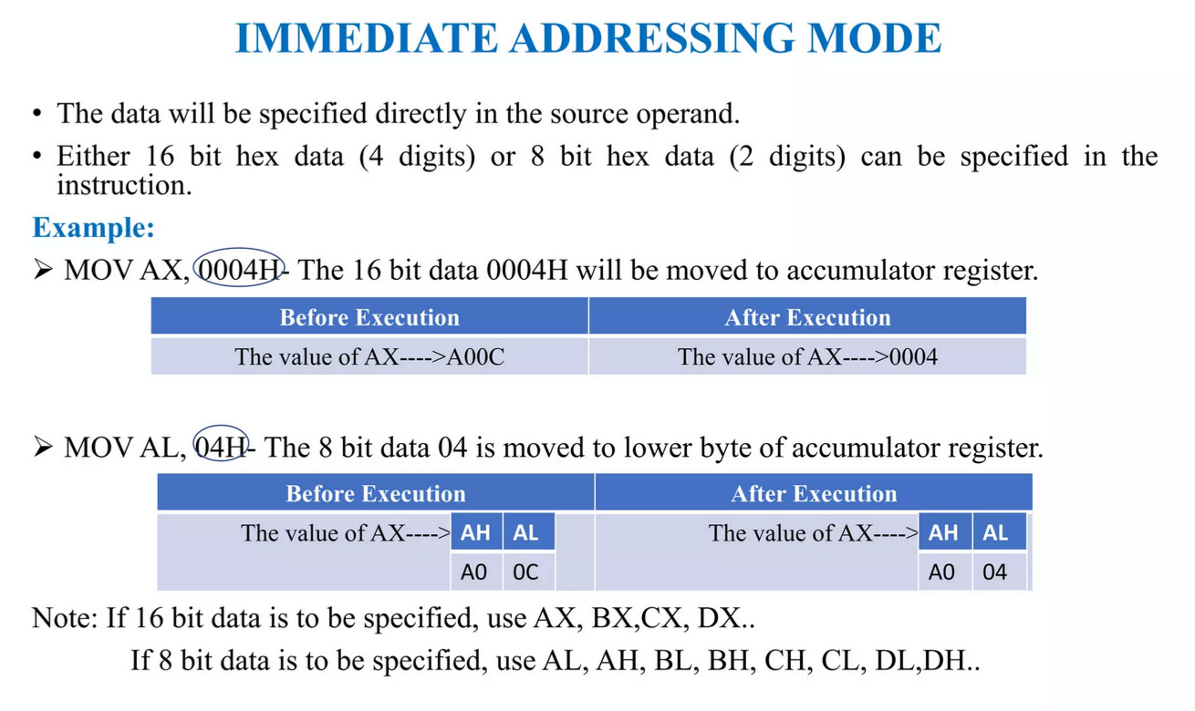

Slide 11
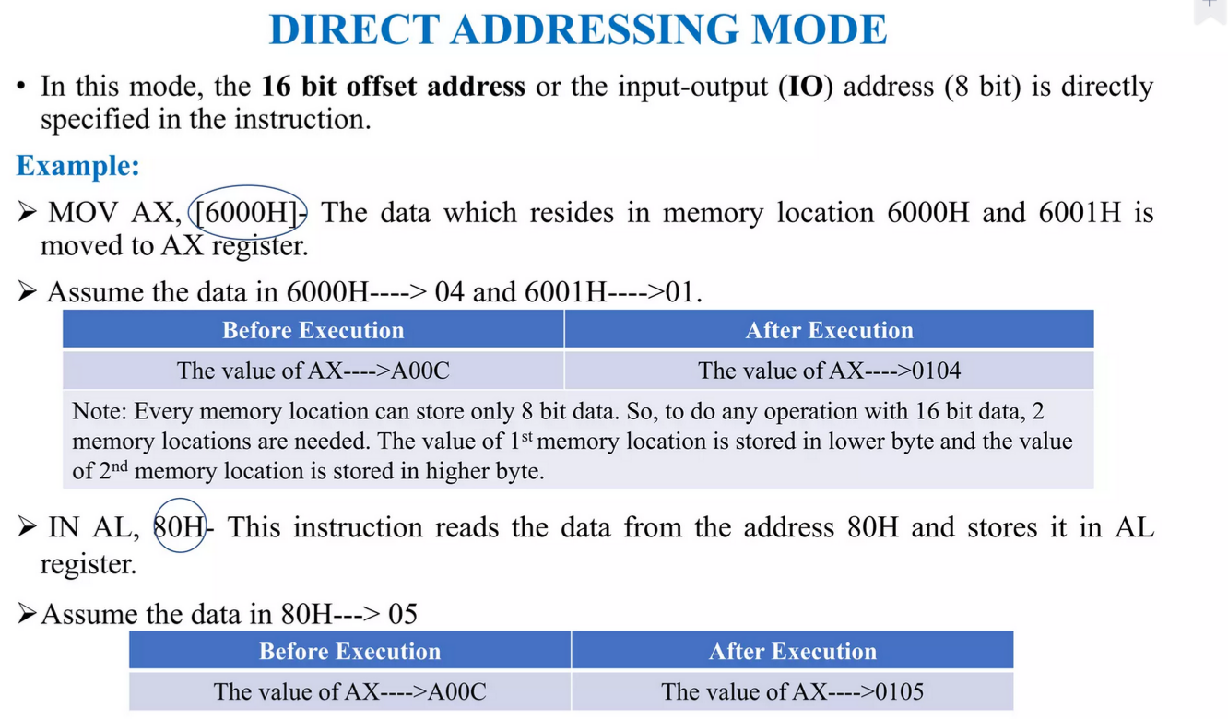

Slide 12
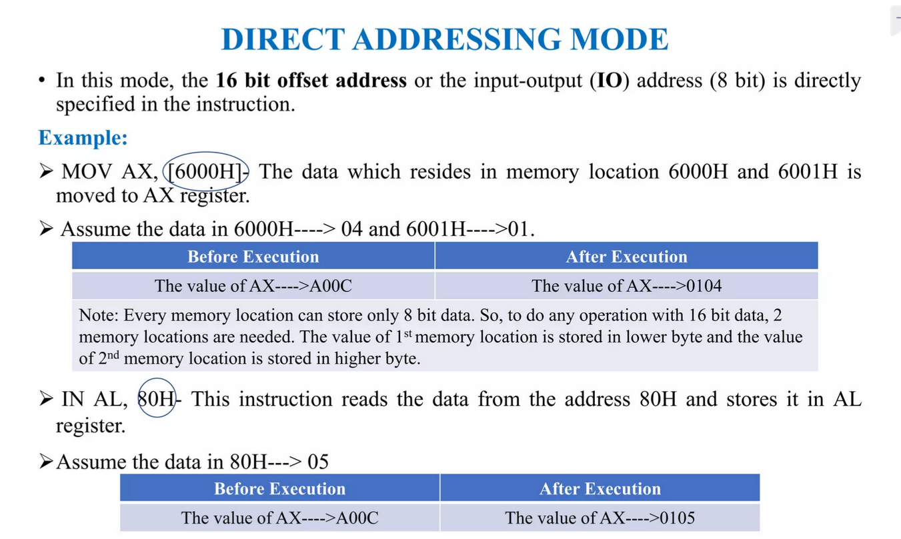

Slide 13
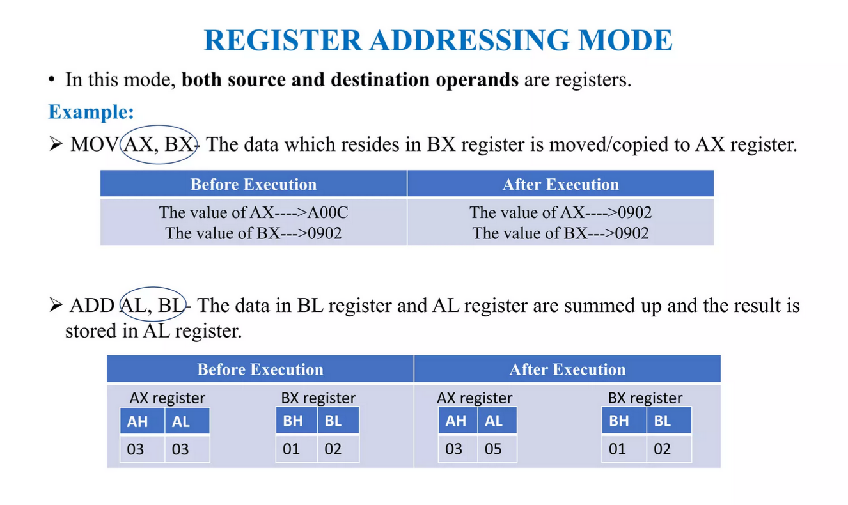

Slide 14
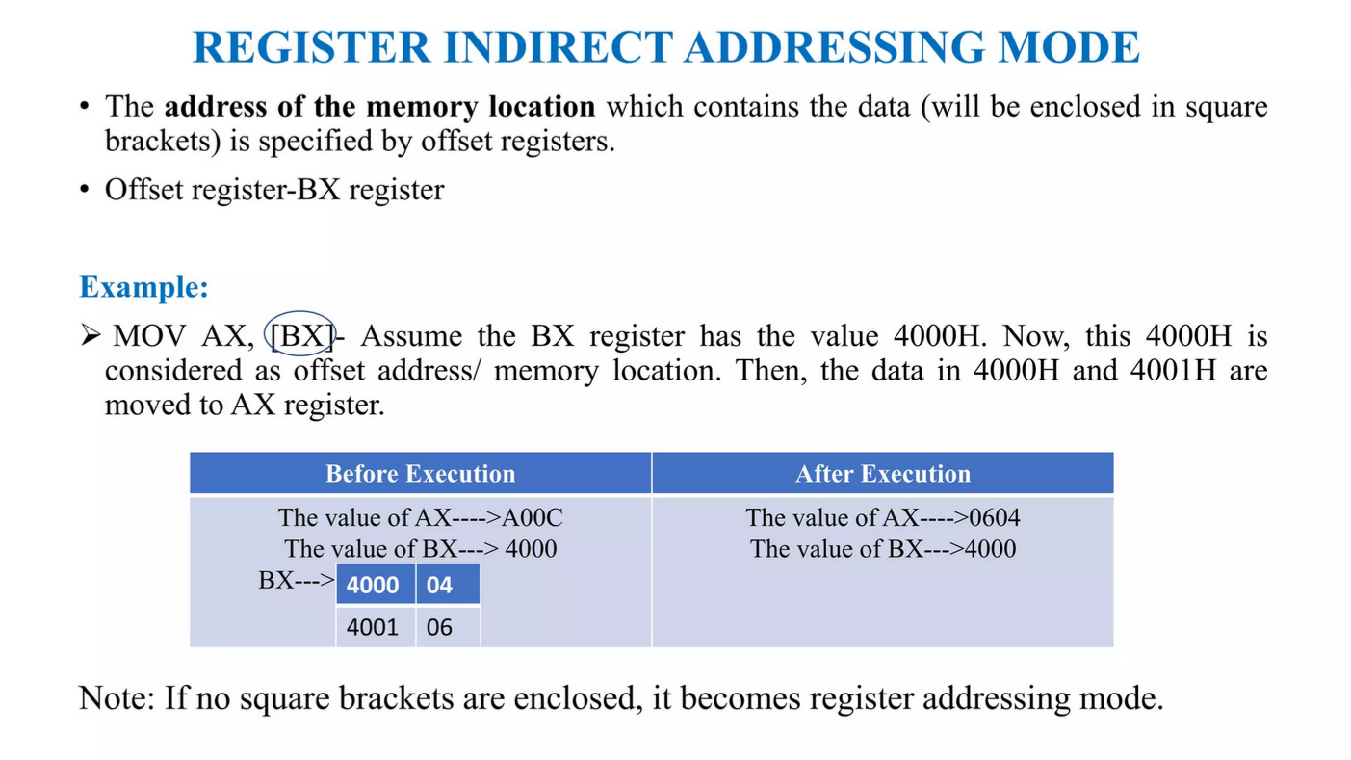

Slide 15
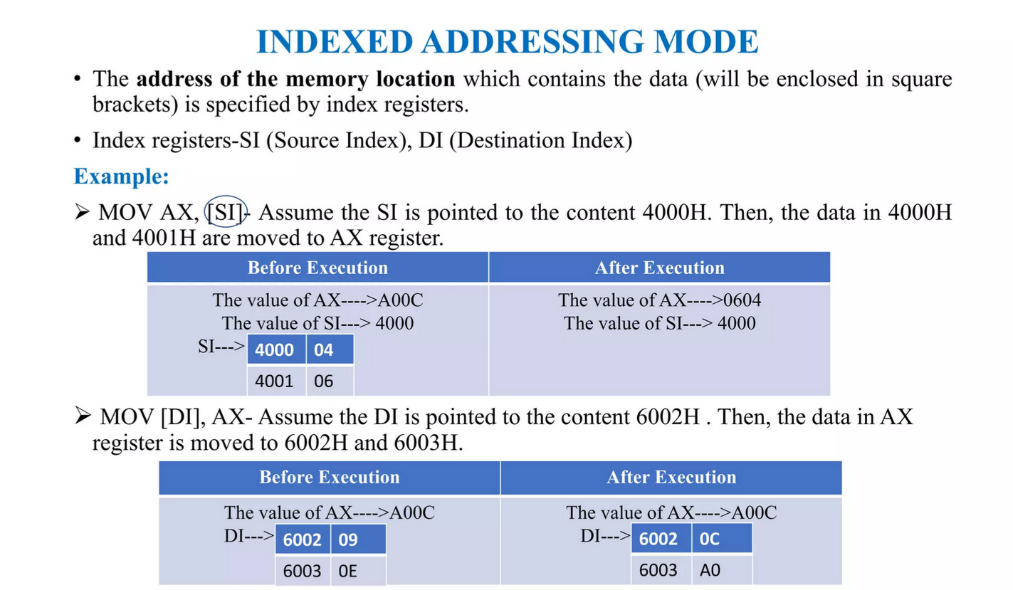

Slide 16
Physical Address to Logical Address
Size of Physical Address is 20bits. While 8086 has max size16 bits.
Physical address will be calculated by Segment address and Offset
Both Segment address and Offset size is 16 bits.
So Physical address is calculated by Segment * 10h + offset address

